Slide 1
LR(0) - Exercises

Slide 2
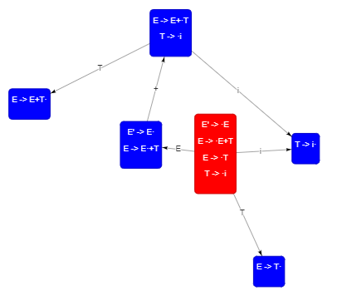
Exercise - 1
Given the following grammar
E → E + T | T
T → i
Construct LR(0) automaton and parse table.

Slide 3
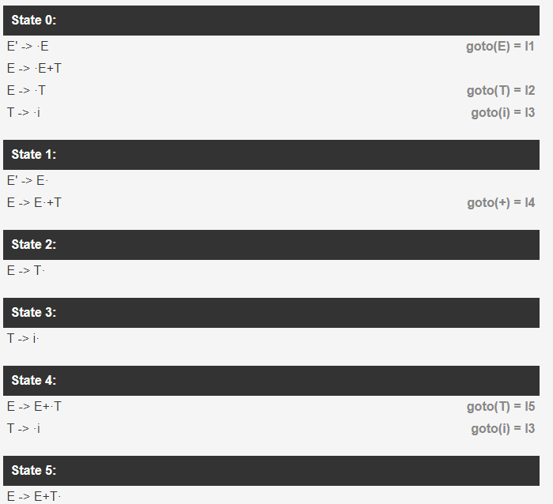
Exercise - 1

Slide 4
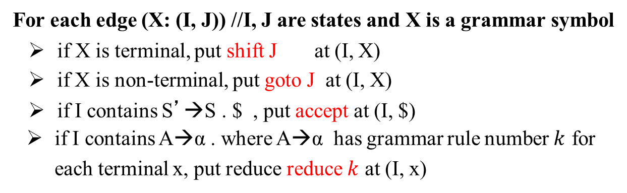
LR(0) parse table construction
Parse table rows: states
columns:
terminals (for shift and reduce actions) non-terminals (for goto actions)

Slide 5
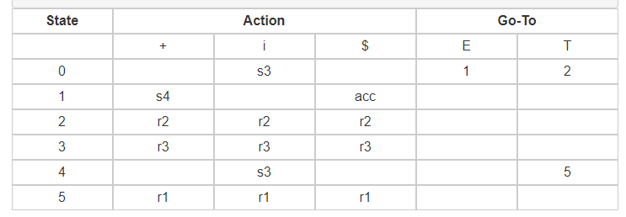
Exercise - 1
Given the following grammar
E → E + T | T
T → i
Construct LR(0) automaton and parse table.

Slide 6
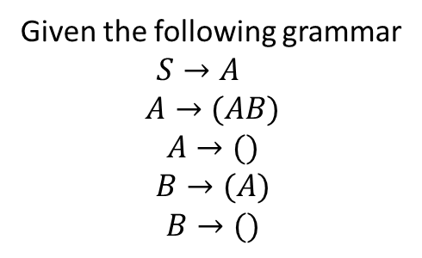
Exercise - 2
Given the following grammar
$S→A$
$$A→(AB)$$
$$A→()$$
$$B→(A)$$
$$B→()$$
Construct LR(0) automaton and parse table.

Slide 7
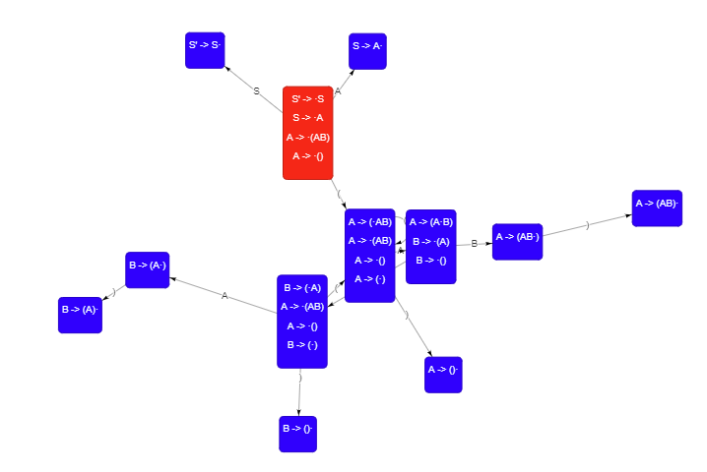
Exercise - 2

Slide 8
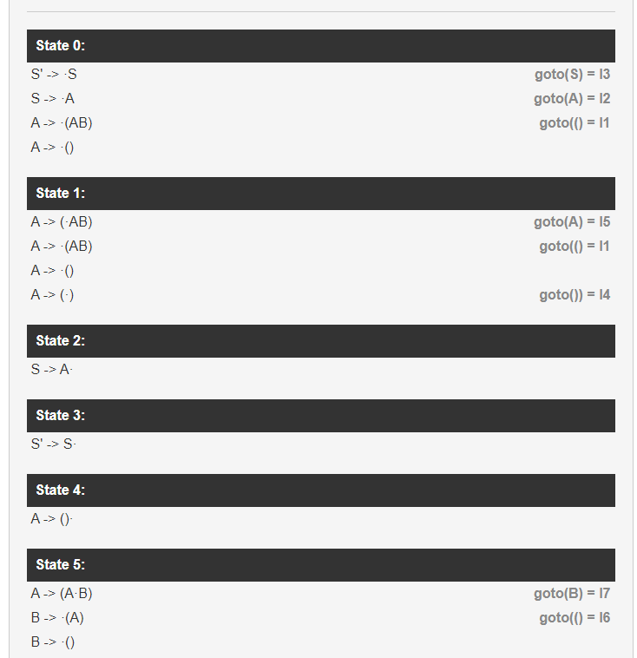
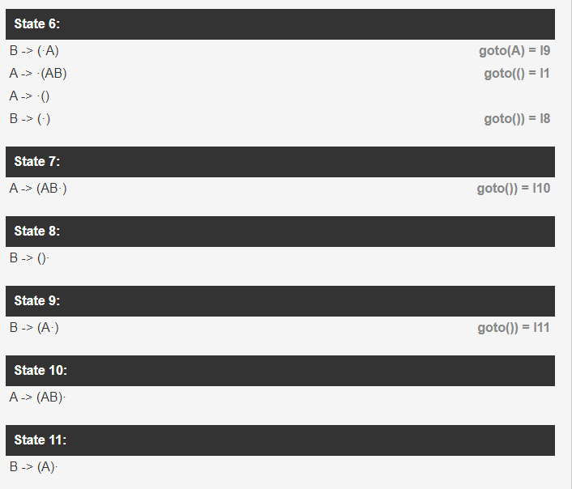
Exercise - 2

Slide 9
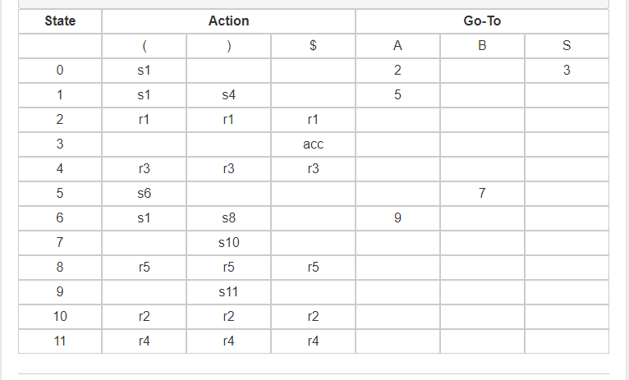
Exercise - 2

Slide 10
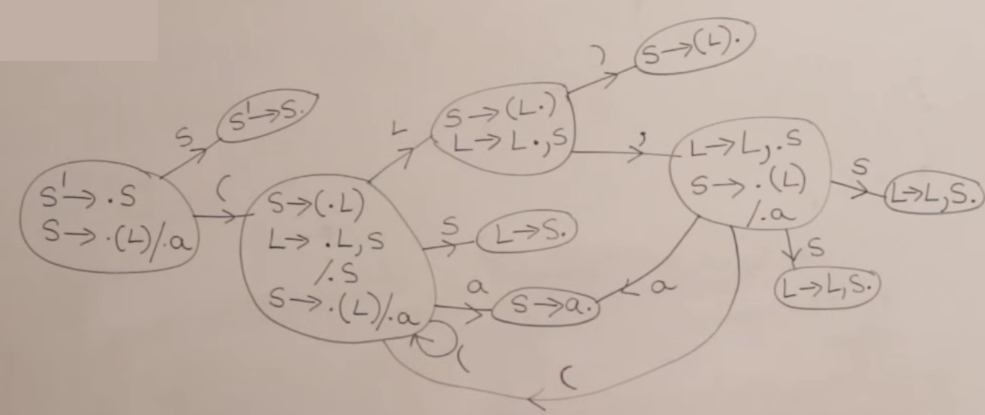
Exercise - 3
S -> (L) | a
L -> L,S | S
Construct LR(0) automaton and parse table.

Slide 11
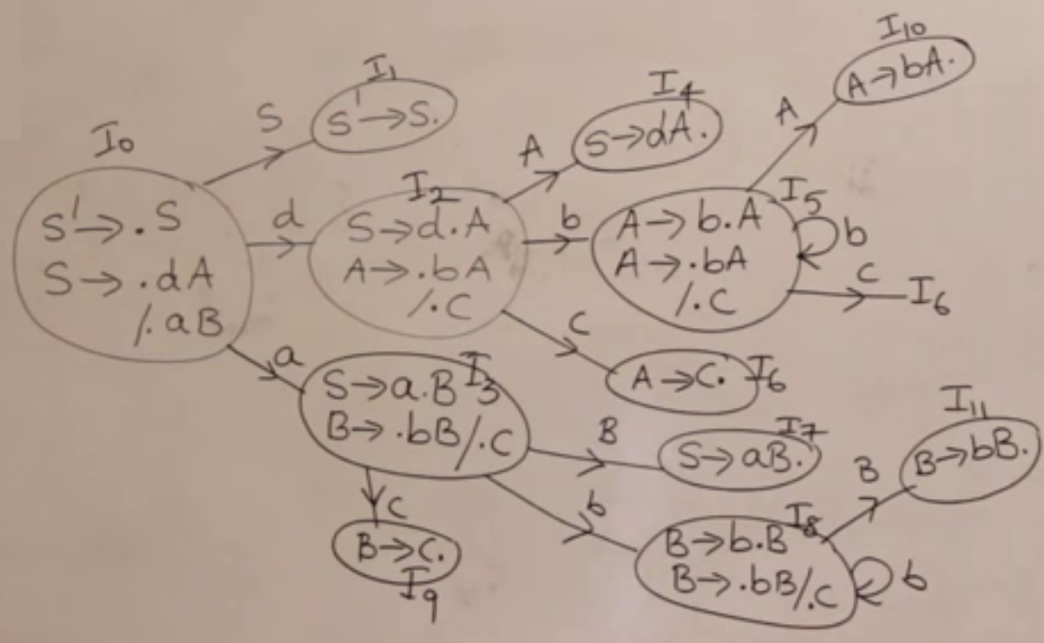
Exercise - 4
Given the following grammar
S → dA | aB
A → bA | c
B → bB| c
Construct LR(0) automaton and parse table.

